Slide 1
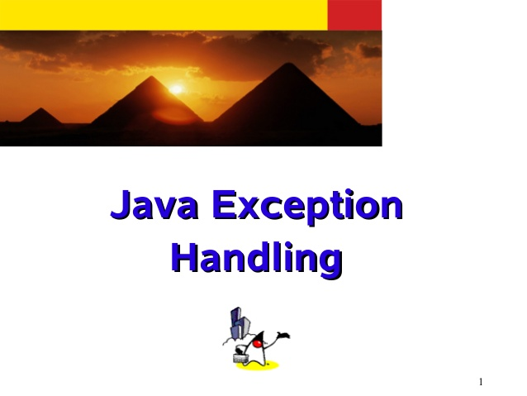
Exceptions

Slide 2
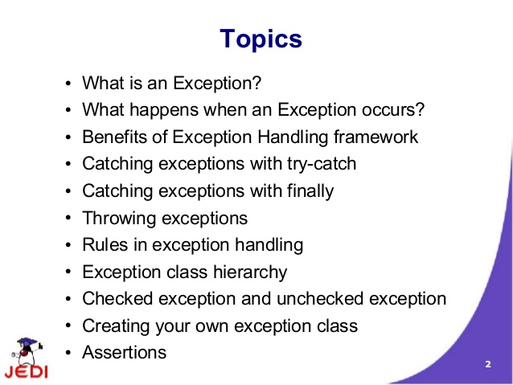
exceptions

Slide 3
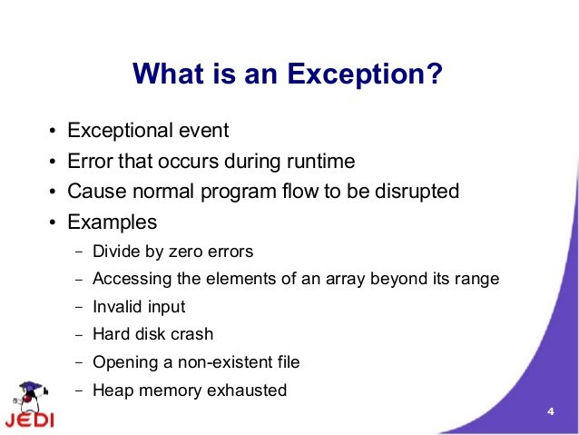
exceptions

Slide 4
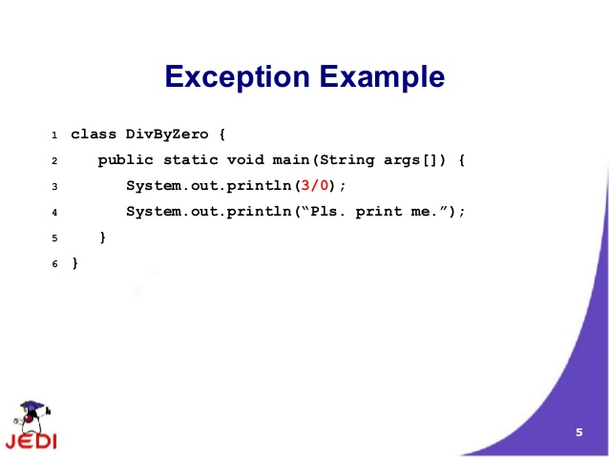
exceptions
Lab14.1: Demonstration of using Exception handling

Slide 5
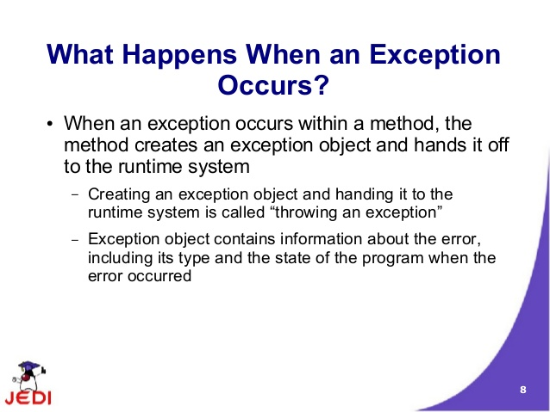
exceptions

Slide 6
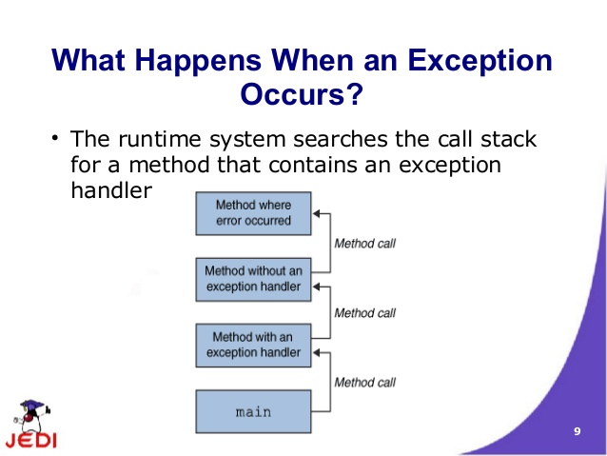
exceptions

Slide 7
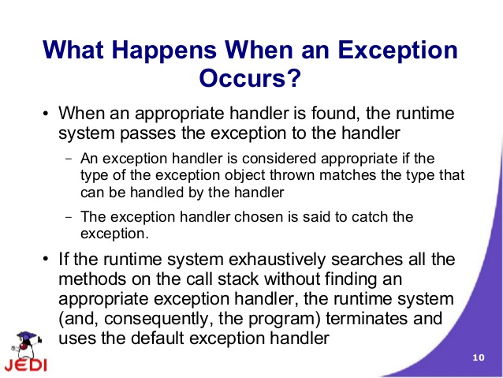
exceptions

Slide 8
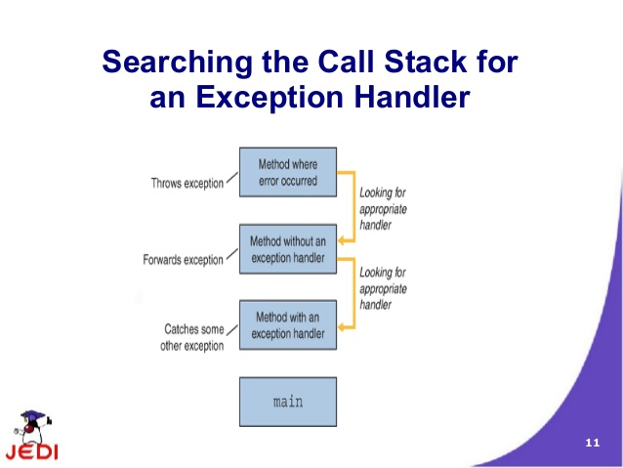
exceptions

Slide 9
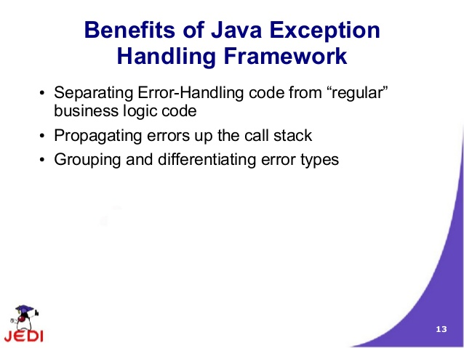
exceptions

Slide 10
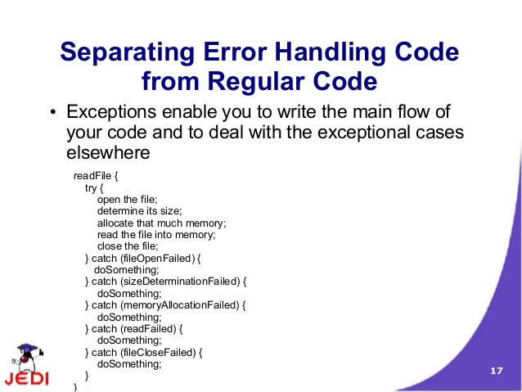
exceptions

Slide 11
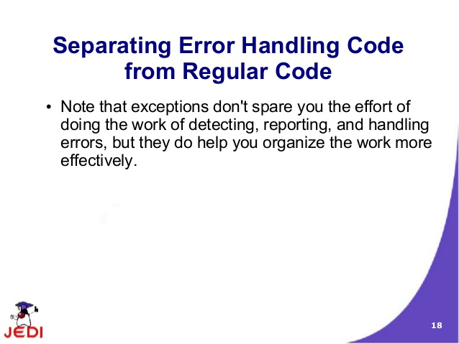
exceptions

Slide 12
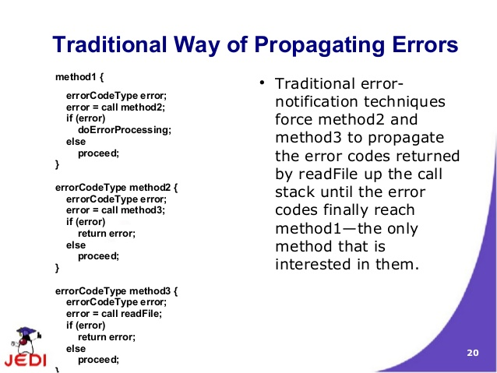
exceptions

Slide 13
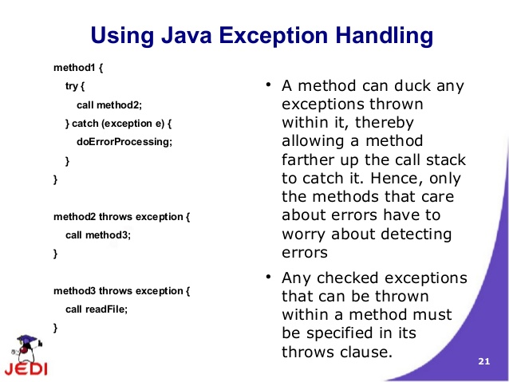
exceptions

Slide 14
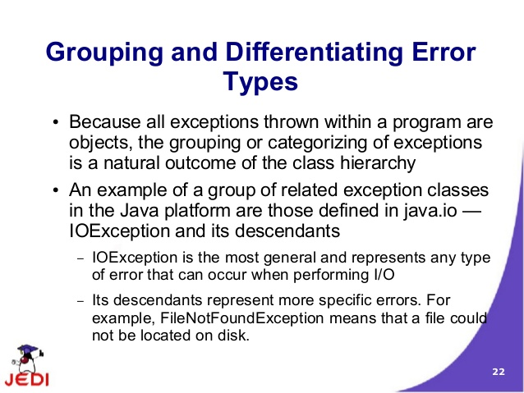
exceptions

Slide 15
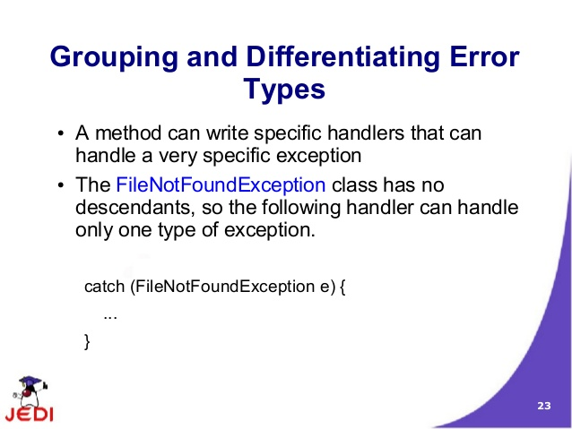
exceptions

Slide 16
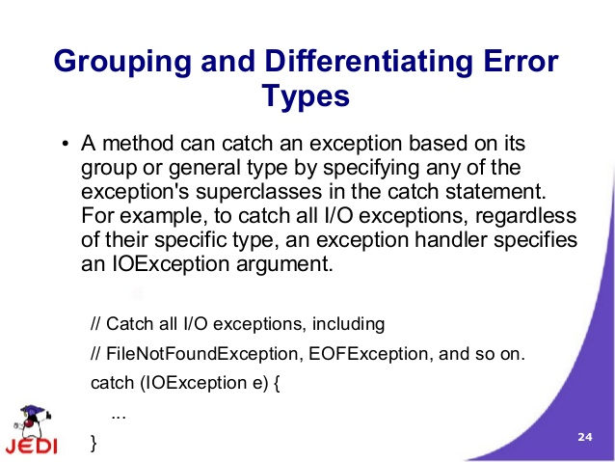
exceptions

Slide 17
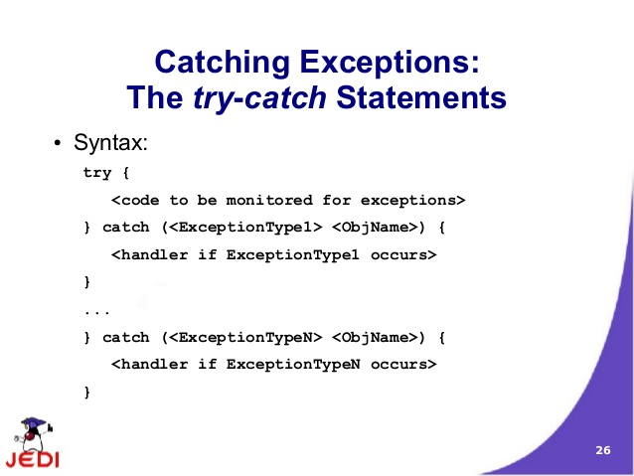
exceptions

Slide 18
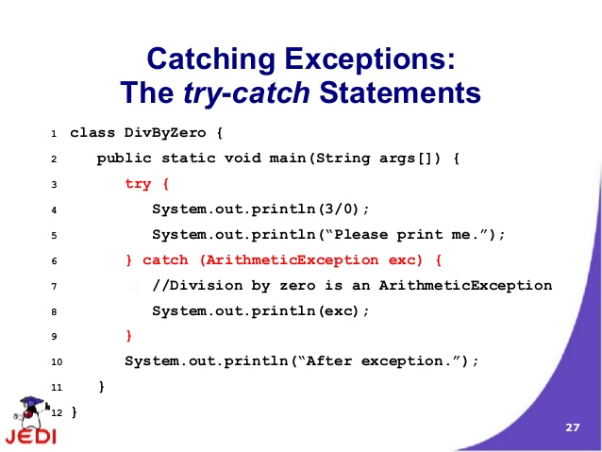
exception

Slide 19
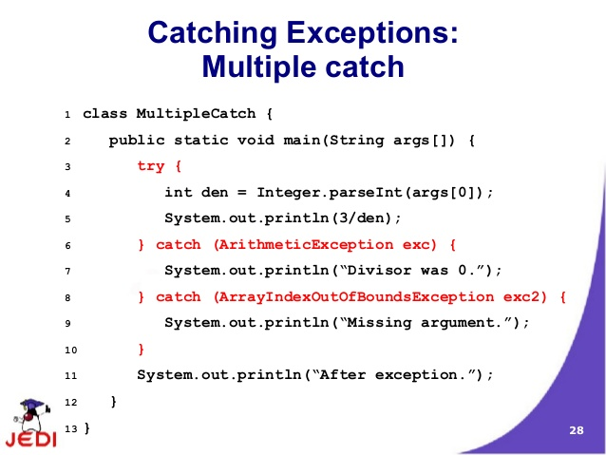
inheritance

Slide 20
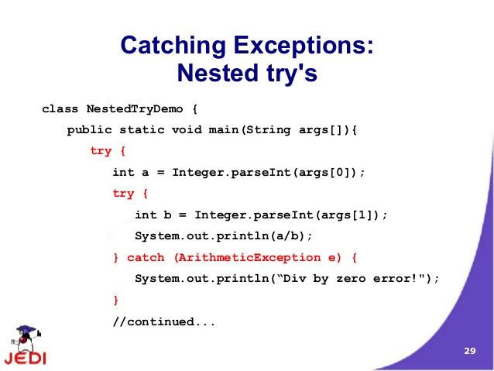
inheritance

Slide 21
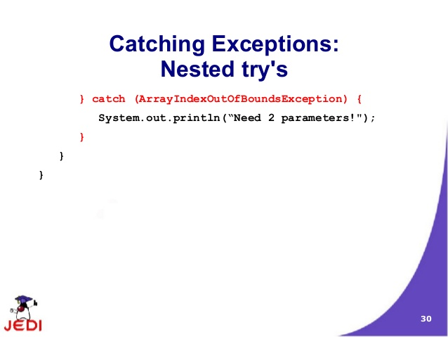
exceptions

Slide 22
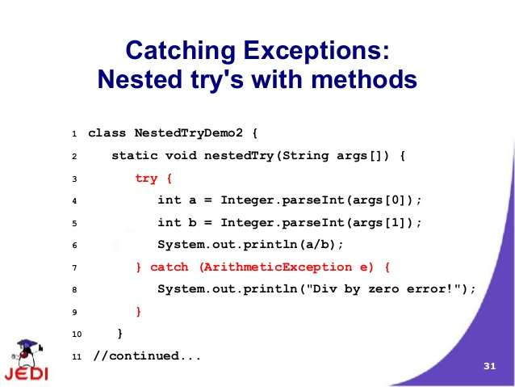
exceptions

Slide 23
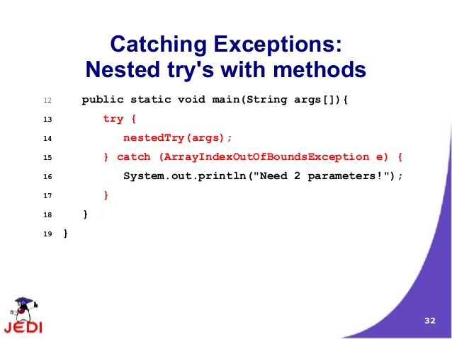
exceptions

Slide 24
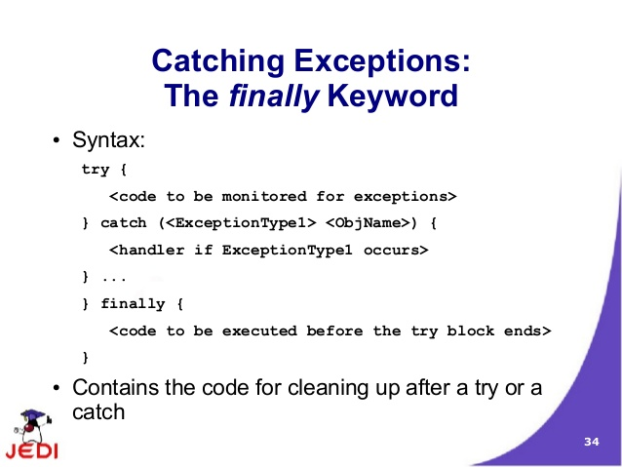
exceptions

Slide 25
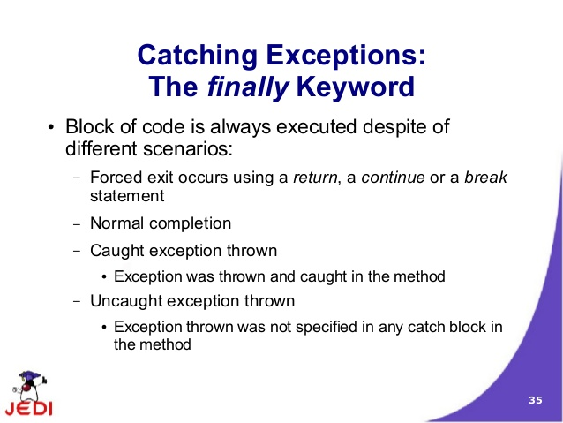
exceptions

Slide 26
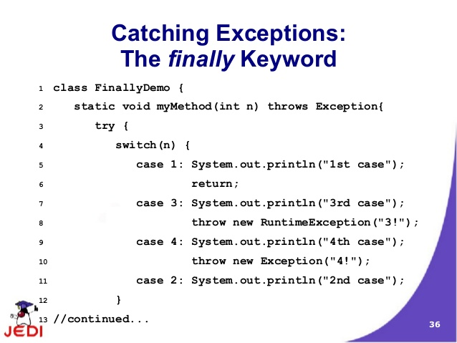
exceptions

Slide 27
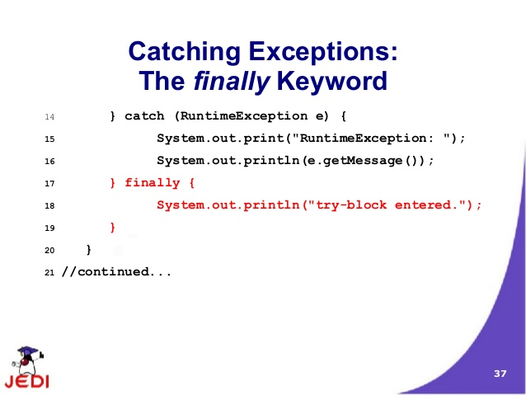
exceptions

Slide 28
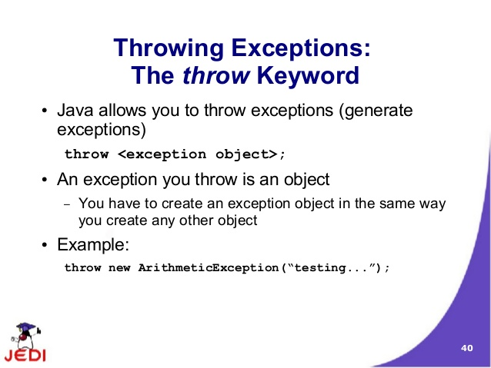
exceptions

Slide 29
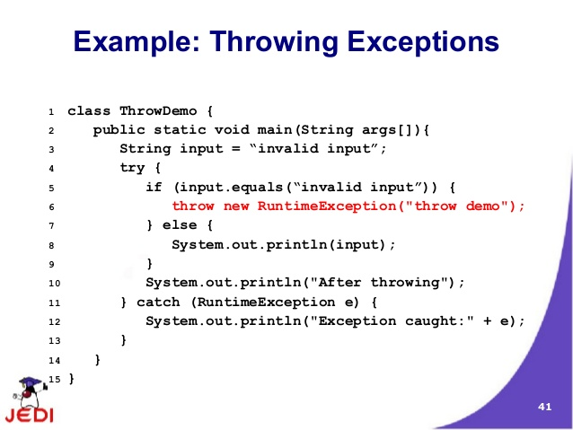
exceptions

Slide 30
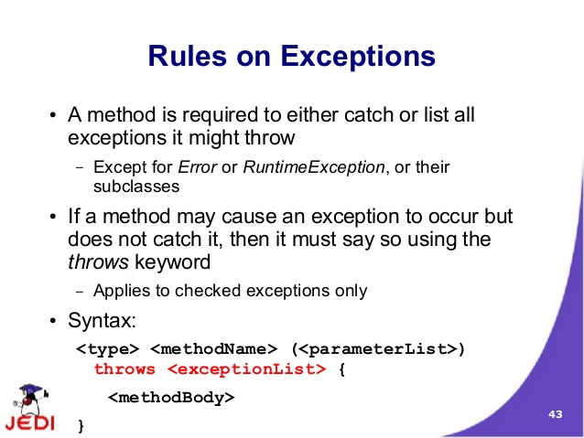
exceptions

Slide 31
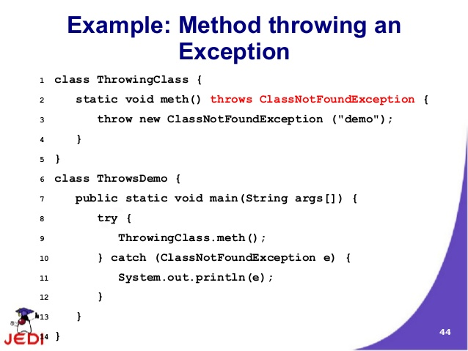
exceptions

Slide 32
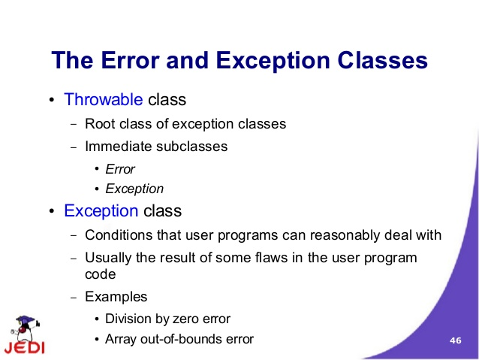
exceptions

Slide 33
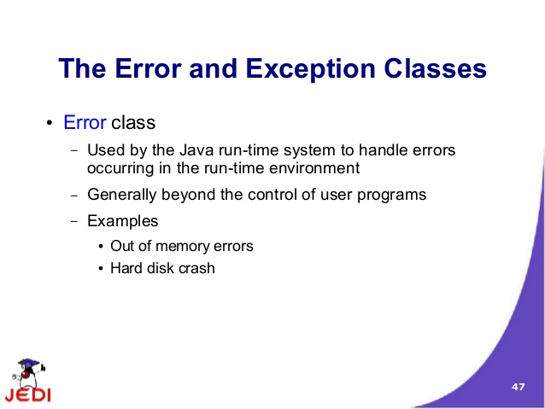
exceptions

Slide 34
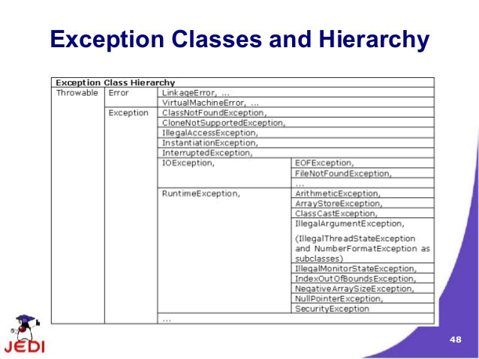
exceptions

Slide 35
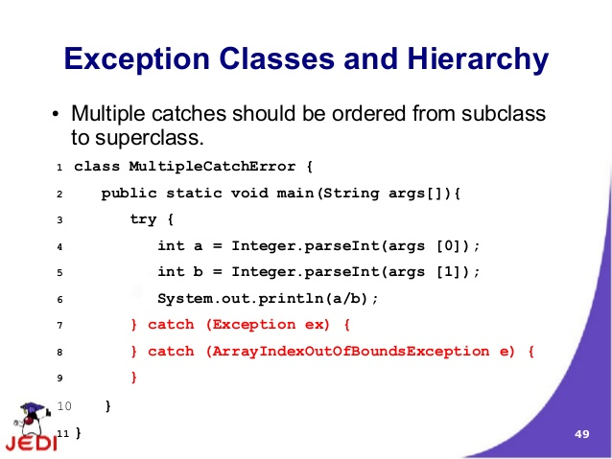
exceptions

Slide 36
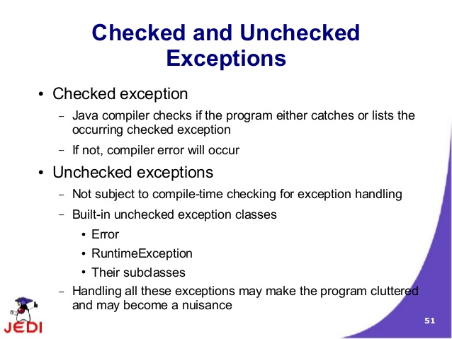
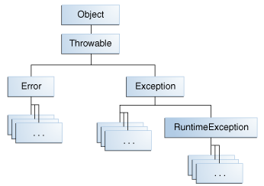
exceptions

Slide 37
exceptions
Checked Exceptions:
The application should anticipate and handle this exception.
Eg: java.io.FileNotFoundException.
All exceptions are checked exceptions, except for those indicated by Error, RuntimeException, and their subclasses
UnChecked Exceptions:
Error:
Exceptional conditions that are external to the application.
Eg: java.io.IOError.
Runtime Exception:
These are exceptional conditions that are internal to the application
application usually cannot anticipate or recover from
Eg: NullPointerException
.

Slide 38
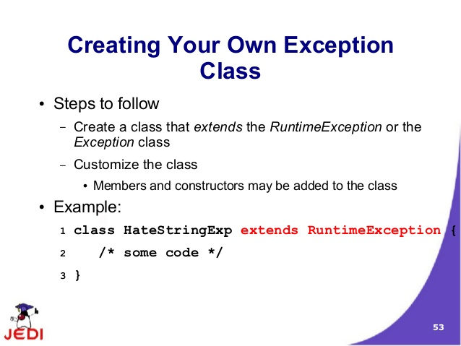
exceptions

Slide 39
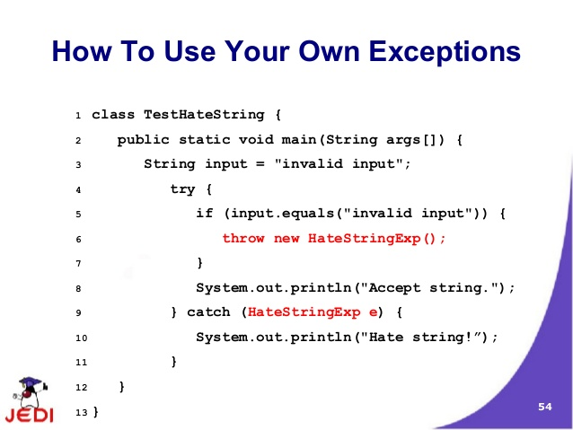
exceptions

Slide 40
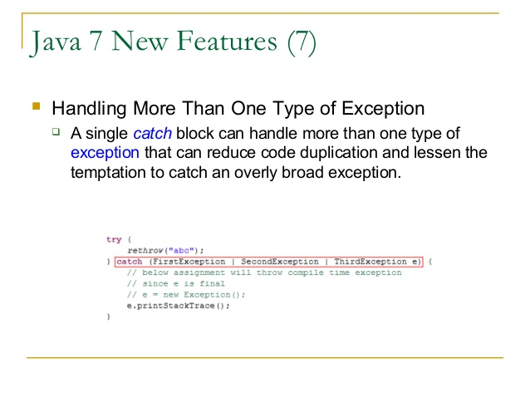
exceptions
Lab14.2: Demonstration of using single exception handler for catching more than one exception
If a catch block handles more than one exception type, then the catch parameter is implicitly final

Slide 41
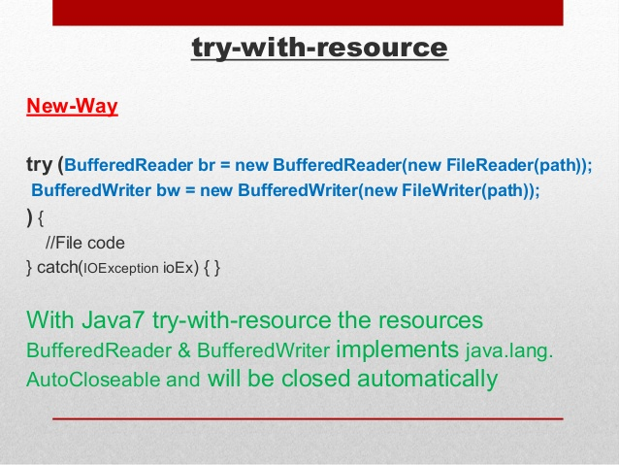
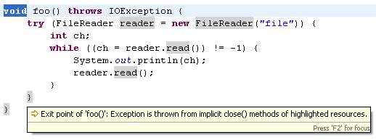
exceptions
A try-with-resources statement can have catch and finally blocks just like an ordinary try statement.
In a try-with-resources statement, any catch or finally block is run after the resources declared have been closed.
Suppressed exceptions by calling the Throwable.getSuppressed method from the exception thrown by the try block

Slide 42
exceptions

Slide 43
exceptions

Slide 44
inheritance

Slide 45
inheritance

Slide 46
inheritance

Slide 47
inheritance

Slide 48
inheritance

Slide 49
inheritance

Slide 50
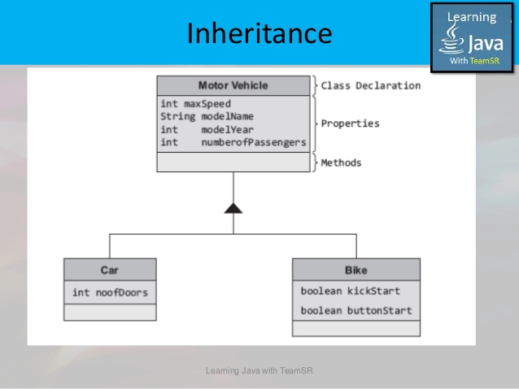
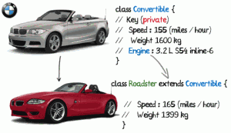
inheritance

Slide 51
Interfaces and inheritance

Slide 52
Java - miscellaneous
Type Comparison Operator instanceof
The instanceof operator compares an object to a specified type.
You can use it to test if an object is an instance of a class, an instance of a subclass, or an instance of a class that implements a particular interface
Classes implementing interfaces
class MyClass extends MySuperClass implements YourInterface {
// field, constructor, and
// method declarations
}

Slide 53
Java - miscellaneous
Varargs – Specifying Arbitrary number of arguments
public Polygon polygonFrom(Point... corners) {
int numberOfSides = corners.length;
double squareOfSide1, lengthOfSide1;
squareOfSide1 = (corners[1].x - corners[0].x)
* (corners[1].x - corners[0].x)
+ (corners[1].y - corners[0].y)
* (corners[1].y - corners[0].y);
lengthOfSide1 = Math.sqrt(squareOfSide1);
// more method body code follows that creates and returns a
// polygon connecting the Points
}
You will most commonly see varargs with the printing methods; for example, this printf method:
public PrintStream printf(String format, Object... args)
allows you to print an arbitrary number of objects. It can be called like this:
System.out.printf("%s: %d, %s%n", name, idnum, address);

Slide 54
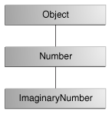
Java - miscellaneous
Returning a Class or Interface
When a method uses a class name as its return type the class of the type of the returned object must be either a subclass of, or the exact class of, the return type.
public Number returnANumber() {
...
}
The returnANumber method can return an ImaginaryNumber but not an Object. ImaginaryNumber is a Number because it's a subclass of Number. However, an Object is not necessarily a Number — it could be a String or another type

Slide 55
Advanced java
Garbage collection
JDBC
Lambda expressions
Annotations

Slide 56
https://docs.oracle.com/javase/tutorial/reallybigindex.html
http://www.slideshare.net/EdurekaIN/java-class-3
http://www.slideshare.net/abdurrehmanabdurrehman391/variables-and-data-types-by-sir-khalid
http://www.slideshare.net/abdurrehmanabdurrehman391/java-advancedoop
http://www.slideshare.net/MindfireSolutions/java-garbage-collection-how-it-works?next_slideshow=1
http://www.slideshare.net/arnold7490/unit-4-java
http://www.slideshare.net/arnold7490/unit-3-java?next_slideshow=1
http://www.slideshare.net/tushardesarda/java-tutorial-3
http://www.slideshare.net/muralidhar9e/java-exception-handling-ppt
http://www.slideshare.net/emprovise/2-javabasics
http://www.slideshare.net/AllanHuang/java-new-evolution

